Slide 1



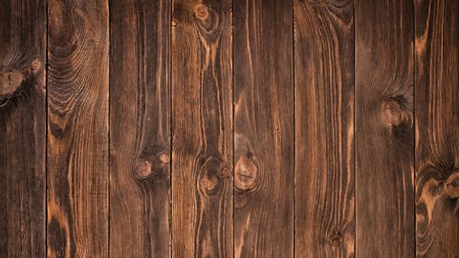
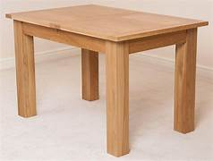
Learning Conversation: Design & Technology
You ask:
Timber
Explain why hardwoods are often used for furniture compared to softwoods.
Give one advantage and one limitation.
Your pupil might say:
Hardwoods are durable and strong, making them ideal for furniture; however, they are more expensive and harder to work with.
Hardwoods have a closer grain structure, so this makes the wood hard and tough to withstand dents and damage from every day wear.
You might ask to help with their answer:
What are the physical properties of hardwood?
What are the mechanical properties of hardwood?
What properties do we want furniture to have? So which wood do you think is most suitable?
Tip: Students often only mention 'hard' vs 'soft' without reasoning about suitability.
Click here for more help

Slide 2
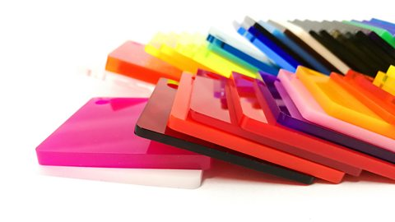
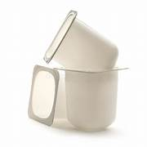
Learning Conversation: Design & Technology
You ask:
Polymers
Describe a situation where you would choose a thermoplastic over a thermosetting plastic.
Explain your choice
Your pupil might say:
Thermoplastics can be reheated and reshaped, making them suitable for products like reusable water bottles or packaging.
Thermoplastics are more suitable to the environment as they can be re used, whereas, thermoset plastics will go to landfill at the end of it’s useful life.
You might ask to help with their answer:
What are the physical properties of thermoplastics?
What are the mechanical properties of thermoplastics?
Tip: Avoid answers that just say 'strong' – focus on heat behaviour and reusability.
Click here for more help

Slide 3
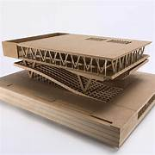
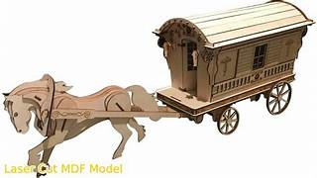
Learning Conversation: Design & Technology
You ask:
Manufactured Board
Compare cardboard and MDF for model-making.
Which would be more suitable for a durable prototype and why?
Your pupil might say:
MDF is stronger and smoother, so it’s better for durable prototypes; cardboard is easier to cut but less robust.
MDF is a resistant material, meaning it will not bend easily. Cardboard is a compliant material, meaning it will bend easily and can be damaged easily.
You might ask to help with their answer:
What are the physical properties of MDF and cardboard?
What are the mechanical properties of MDF and cardboard?
Tip: Don’t just state material properties; link them to the purpose of the product.
Click here for more help

Slide 4
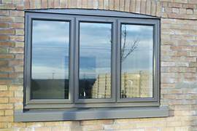
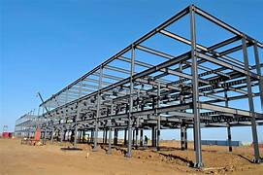
Learning Conversation: Design & Technology
You ask:
Metals
Aluminium and steel are both metals used in products.
Explain one reason to choose aluminium and one reason to choose steel.
Your pupil might say:
Aluminium is lightweight and corrosion resistant, suitable for window frames. Aluminium is a non-ferrous metal, which means it does not contain iron. Aluminium is a pure metal found on the periodic table.
Steel is strong, suitable for structural components. It is a ferrous metal which means it contains iron, which means it will rust.
You might ask to help with their answer:
What are the physical properties of Aluminium and Steel?
What are the mechanical properties of Aluminium and Steel?
Tip: Students often forget to consider both functional requirements and environmental conditions.
Click here for more help

Slide 5
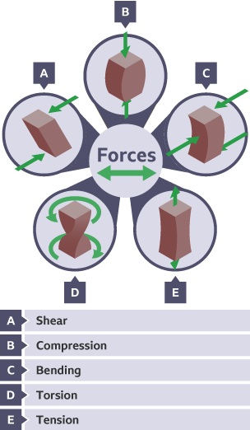
Learning Conversation: Design & Technology
Your pupil might say:
Compression and tension act on the bridge
Steel resists both effectively due to its bending strength.
You ask:
Forces and Stresses:
A bridge must support cars and pedestrians. Name two forces acting on it and explain how the material choice could resist them.
You might ask to help with their answer:
Give examples of each of the five forces.
Tip: Don’t just name forces – link to material behaviour.
Click here for more help.

Slide 6
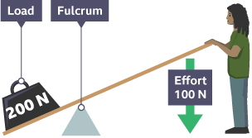
Learning Conversation: Design & Technology
You ask:
Mechanisms
A bottle opener uses a lever. Explain how the lever helps lift the cap and why the length of the lever matters.
Your pupil might say:
The lever multiplies force, making it easier to lift the cap; a longer lever requires less effort.
.
You might ask to help with their answer:
Use the image to help you to explain your answer.
Tip: Students often mention levers but forget to explain how force is multiplied.
Click here for more help.

Slide 7


Learning Conversation: Design & Technology
You ask:
Electronics
A circuit needs to reduce current to a LED. Explain how a resistor achieves this and why it is important.
Your pupil might say:
The resistor limits current flow, preventing the LED from burning out.
You might ask to help with their answer:
What are the components of a circuit board?
Tip: Students often confuse resistors with switches or think resistors store energy.
Click here for more help.

Slide 8
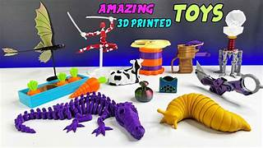

Learning Conversation: Design & Technology
You ask:
Manufacturing Processes
Describe one advantage of using CAD and CAM in producing a small batch of toys, and one limitation.
Your pupil might say:
CAD/CAM allows precise, repeatable designs and faster production; limitation is the initial cost of software and machinery.
You might ask to help with their answer:
Explain what CAD means.
Explain what CAM means.
What toys can you think of which have been made using CAM?
Tip: Avoid vague answers like 'it is better' – focus on measurable benefits and constraints.
Click here for more help

Slide 9
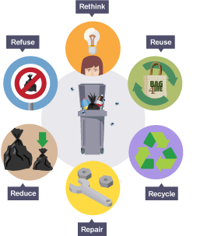
Learning Conversation: Design & Technology
You ask:
Sustainability
Suggest two ways a designer could reduce the environmental impact of a product, explaining why each is effective.
Your pupil might say:
Use recycled materials (reduces raw material extraction); design for disassembly (easier recycling and repair).
You might ask to help with their answer:
Give examples of each of the 6Rs. This will help you to answer the question.
Tip: Students often only mention recycling; explain why each choice matters.
Click here for more help

Slide 10
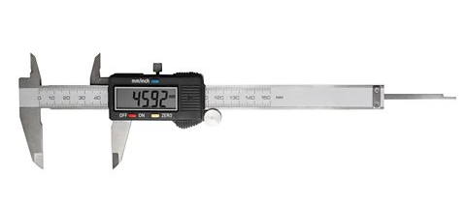
Learning Conversation: Design & Technology
You ask:
Maths & Tolerances
A part must fit into a hole. Explain why tolerances are needed and what could happen if they are ignored.
Your pupil might say:
Tolerances allow for small manufacturing variations; ignoring them could make parts too tight or too loose.
You might go through the following to help with their answer:
Example
If a length of timber is measured with a tape measure, it could be written that the timber is 1,000mm +/- 1mm. This indicates that the timber could be 999 mm or 1,001 mm.
1,000 mm + 1 mm = 1,001 mm
1,000 mm - 1 mm = 999 mm
The range of possible sizes is anywhere between 999 mm and 1,001 mm. This means that some lengths might be 2 mm bigger than others.
If the tolerance was +/- 2 mm:
1000 mm + 2 mm = 1,002 mm
1000 mm - 2 mm = 998 mm
The range of possible sizes is anywhere between 998 mm and 1,002 mm and some lengths might be 4 mm bigger than others.
Tip: Students sometimes confuse tolerance with quality – it’s about acceptable variation, not error prevention.
Click here for more help

